Slide 1




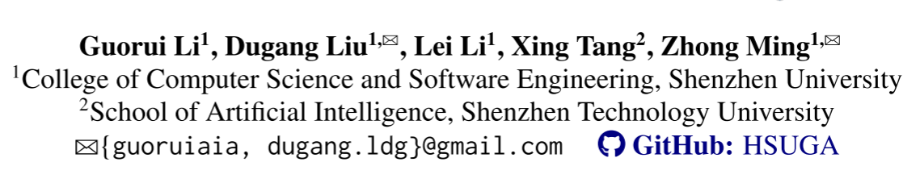





ATAI
Advanced Technique of Artificial Intelligence
ATAI
ChongqingUniversity _{AdvancedTechniqueof}
of Technology Artificial Intelligence
Chongqing University of
Technology
Chongqing University ^{ATAI}
_{of Technology} Advanced Techniqueof
Artificial Intelligence
Chongqing University of Technology
Chongqing University of Technology
HSUGA: LLM-Enhanced Recommendation with Hierarchical Semantic
Understanding and Group-Aware Alignment
code: https://github.com/lilxmx/HSUGA
——ACL_2026
Reported by Bingqian Fan
1

Slide 2
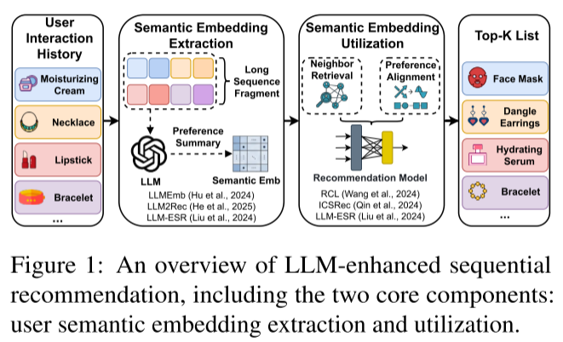
ATAI
Advanced Technique of Artificial Intelligence
ATAI
ChongqingUniversity _{AdvancedTechniqueof}
of Technology Artificial Intelligence
Chongqing University of
Technology
Chongqing University ^{ATAI}
_{of Technology} Advanced Techniqueof
Artificial Intelligence
Chongqing University of Technology
Chongqing University of Technology
Motivation
1.Directly feeding excessively long interac-tion sequences into LLMs increases inference difficulty, making accurate user embedding extraction challenging.
2.Applying a uniform semantic embedding strategy to all users ignores activity differences, resulting in suboptimal performance.
Notes:
同质图：节点都是一种类型，例如“用户”。边也是一种类型， “交互”。U-I图其实就是异构图

Slide 3
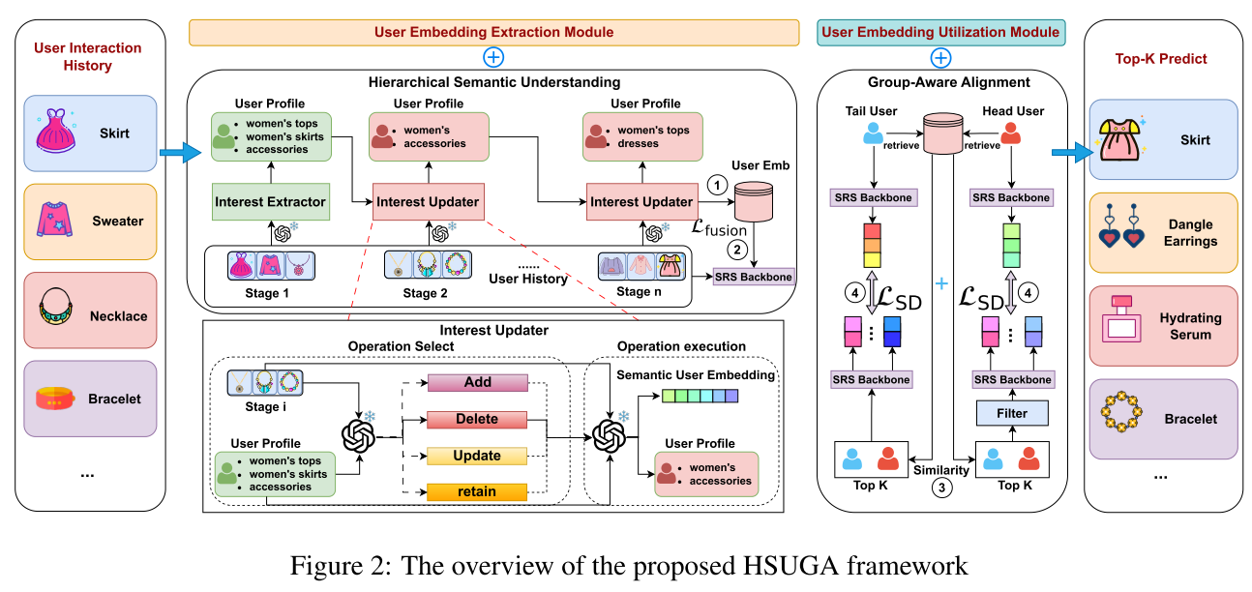
ATAI
Advanced Technique of Artificial Intelligence
ATAI
ChongqingUniversity _{AdvancedTechniqueof}
of Technology Artificial Intelligence
Chongqing University of
Technology
Chongqing University ^{ATAI}
_{of Technology} Advanced Techniqueof
Artificial Intelligence
Chongqing University of Technology
Chongqing University of Technology
Overview
Notes:
同质图：节点都是一种类型，例如“用户”。边也是一种类型， “交互”。U-I图其实就是异构图

Slide 4
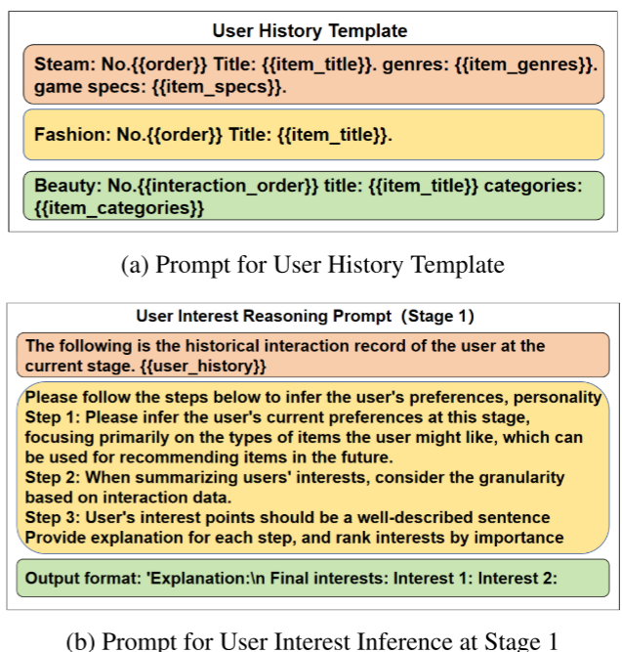
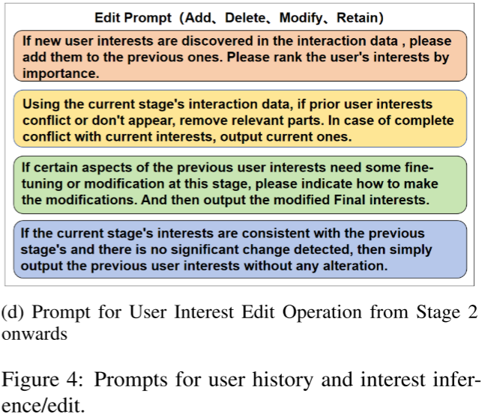
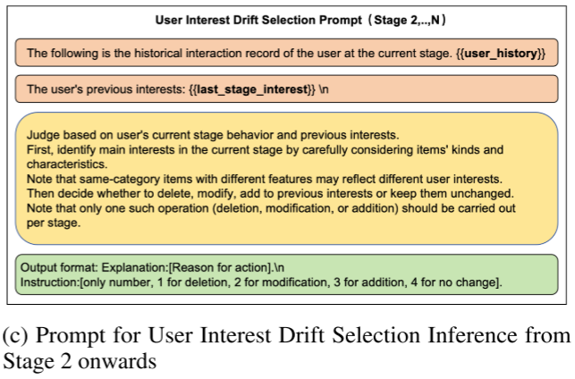
ATAI
Advanced Technique of Artificial Intelligence
ATAI
ChongqingUniversity _{AdvancedTechniqueof}
of Technology Artificial Intelligence
Chongqing University of
Technology
Chongqing University ^{ATAI}
_{of Technology} Advanced Techniqueof
Artificial Intelligence
Chongqing University of Technology
Chongqing University of Technology
Overview
Notes:
同质图：节点都是一种类型，例如“用户”。边也是一种类型， “交互”。U-I图其实就是异构图

Slide 5
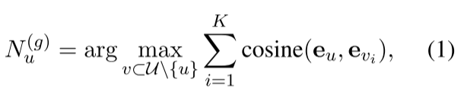


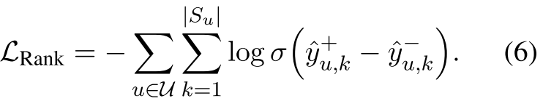
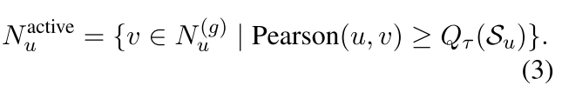

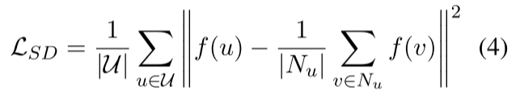

ATAI
Advanced Technique of Artificial Intelligence
ATAI
ChongqingUniversity _{AdvancedTechniqueof}
of Technology Artificial Intelligence
Chongqing University of
Technology
Chongqing University ^{ATAI}
_{of Technology} Advanced Techniqueof
Artificial Intelligence
Chongqing University of Technology
Chongqing University of Technology
Method

Slide 6

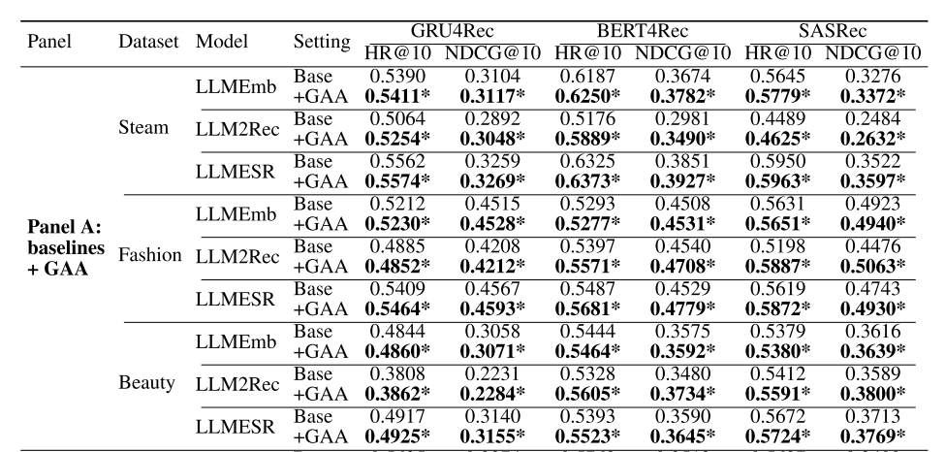
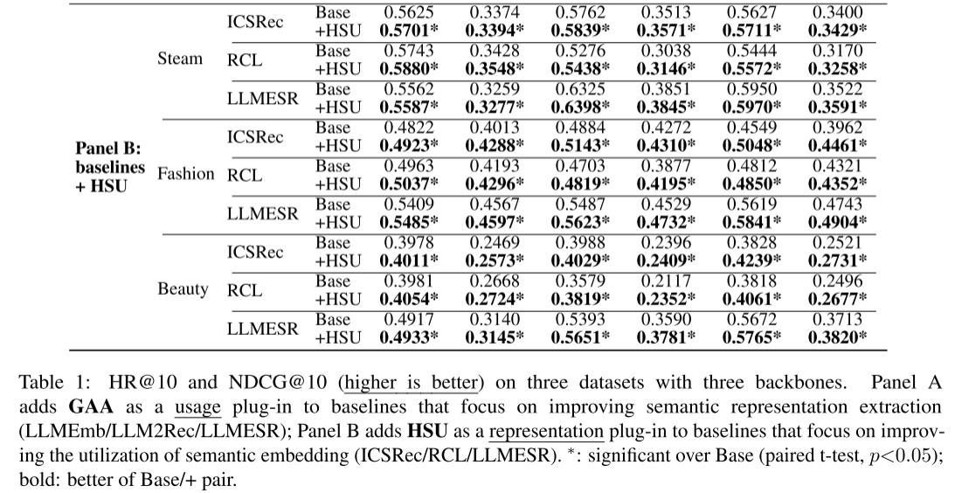
ATAI
Advanced Technique of Artificial Intelligence
ATAI
ChongqingUniversity _{AdvancedTechniqueof}
of Technology Artificial Intelligence
Chongqing University of
Technology
Chongqing University ^{ATAI}
_{of Technology} Advanced Techniqueof
Artificial Intelligence
Chongqing University of Technology
Chongqing University of Technology

Slide 7
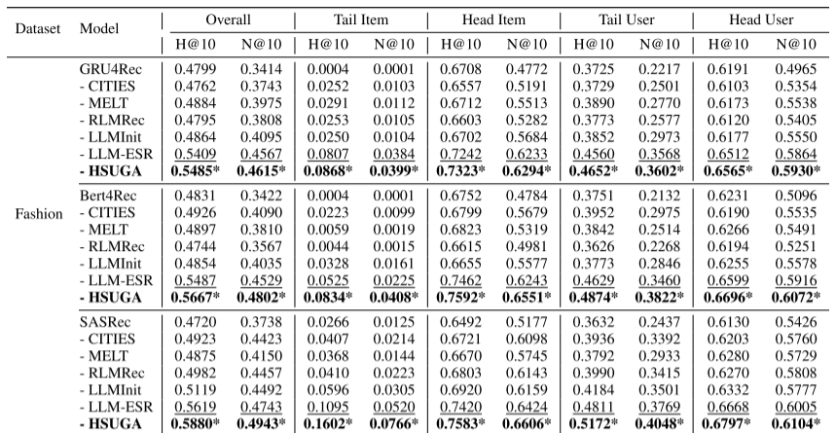
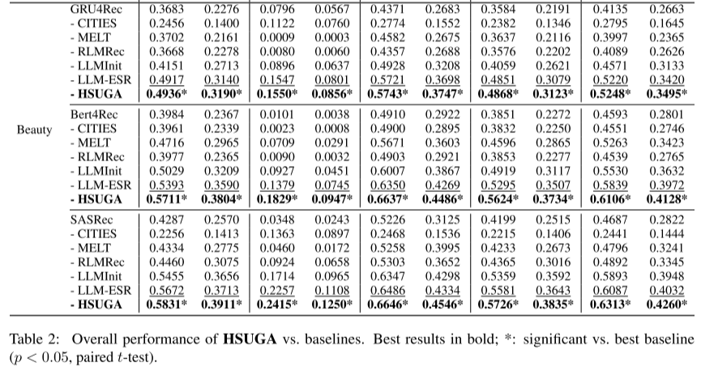
ATAI
Advanced Technique of Artificial Intelligence
ATAI
ChongqingUniversity _{AdvancedTechniqueof}
of Technology Artificial Intelligence
Chongqing University of
Technology
Chongqing University ^{ATAI}
_{of Technology} Advanced Techniqueof
Artificial Intelligence
Chongqing University of Technology
Chongqing University of Technology

Slide 8
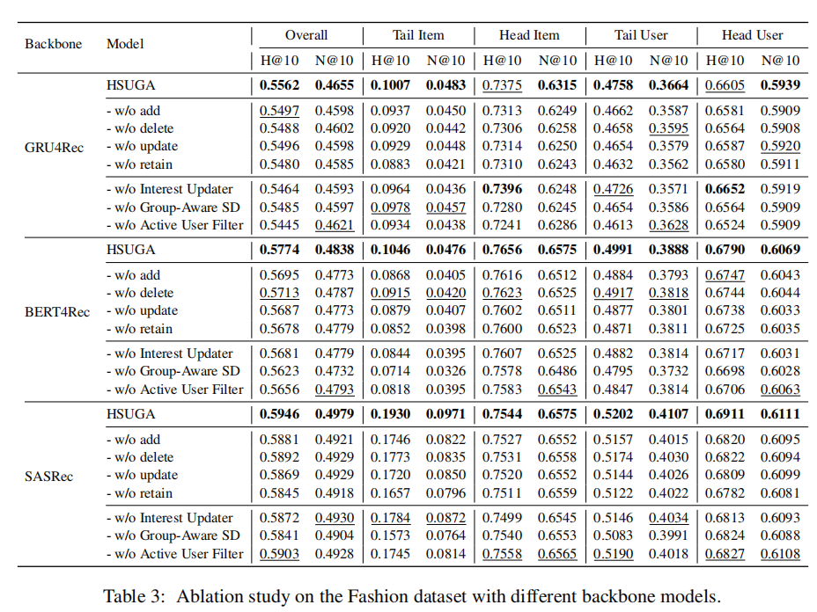
ATAI
Advanced Technique of Artificial Intelligence
ATAI
ChongqingUniversity _{AdvancedTechniqueof}
of Technology Artificial Intelligence
Chongqing University of
Technology
Chongqing University ^{ATAI}
_{of Technology} Advanced Techniqueof
Artificial Intelligence
Chongqing University of Technology
Chongqing University of Technology

Slide 9
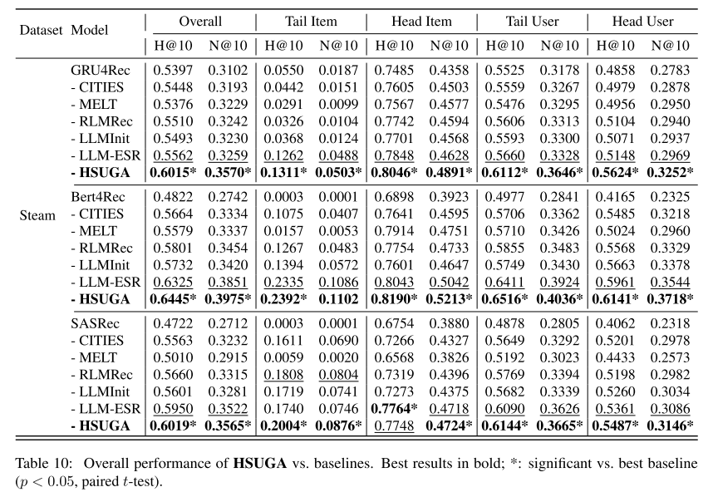
ATAI
Advanced Technique of Artificial Intelligence
ATAI
ChongqingUniversity _{AdvancedTechniqueof}
of Technology Artificial Intelligence
Chongqing University of
Technology
Chongqing University ^{ATAI}
_{of Technology} Advanced Techniqueof
Artificial Intelligence
Chongqing University of Technology
Chongqing University of Technology

Slide 10
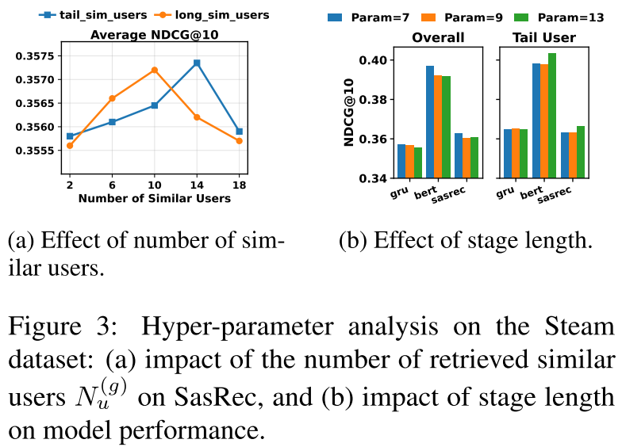
ATAI
Advanced Technique of Artificial Intelligence
ATAI
ChongqingUniversity _{AdvancedTechniqueof}
of Technology Artificial Intelligence
Chongqing University of
Technology
Chongqing University ^{ATAI}
_{of Technology} Advanced Techniqueof
Artificial Intelligence
Chongqing University of Technology
Chongqing University of Technology

Slide 11


ATAI
Advanced Technique of Artificial Intelligence
ATAI
ChongqingUniversity _{AdvancedTechniqueof}
of Technology Artificial Intelligence
Chongqing University of
Technology
Chongqing University ^{ATAI}
_{of Technology} Advanced Techniqueof
Artificial Intelligence
Chongqing University of Technology
Chongqing University of Technology
Thanks!

